Slide 1
Project Presentation Module 9
Presented To:
Mohammad Moshaidul Islam
IT consultant at Show & Tell Consulting Ltd.
Supervised By:
Md. Rajaul Islam
Java Trainer at CCSL

Slide 2
Presented By
Md. Minhazur Rahman
ESAD-J2EE
Trainee ID:1246991
Batch ID:J2EE/CCSL-A/39-01
Round:39
Submission Date:29-07-19
Submission Date:02-7-19

Slide 3
Project Specifications
Project Name: Dining System Automation
Technology Used: Spring Boot, Bootstrap, MySql, Core java

Slide 4
Software Requirements Analysis
1. Introduction
2. Functional Requirements
3. Non Functional Requirements

Slide 5
1. Introduction
The system we required need to maintain contacts. The will be many which contacts which will saved and updated when need
A computerized maintenance system will be helpful for maintaining activity. It is very difficult to keeping records manually

Slide 6
2.0 Functional Requirements
Actor
User’s responsibilities
User will save new contacts
Will update contacts when need.
All contacts will be shown at a time member.
User will find any contact by searching when need.
There will be one type of actor .Only user

Slide 7
3.0 Software Requirements Specification
Non Functional Requirements
The software should be very light.
User interface will be looking gorgeous.
Wont consume very large memory.
System should be vey secured.

Slide 8
Use cases Diagrams

Slide 9
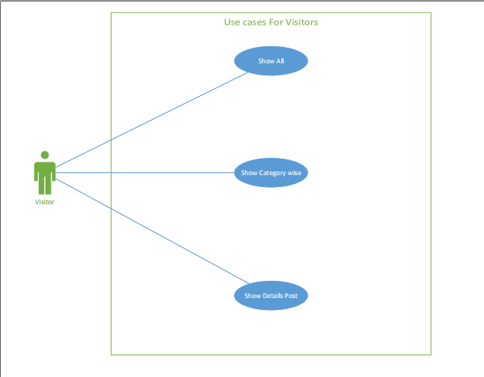

Slide 10
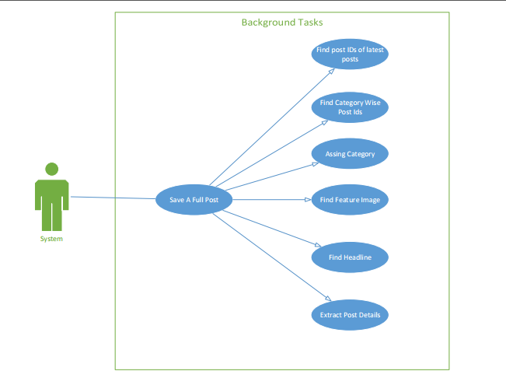

Slide 11
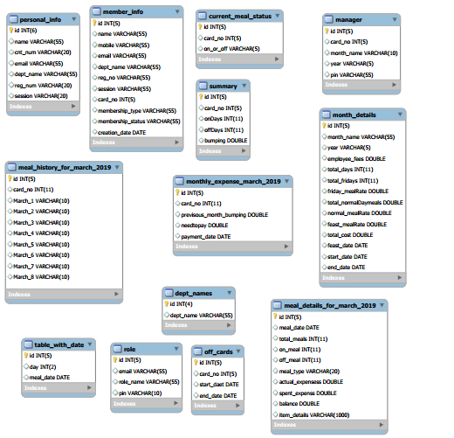
Class Diagram

Slide 12
How To Operate the Software

Slide 13
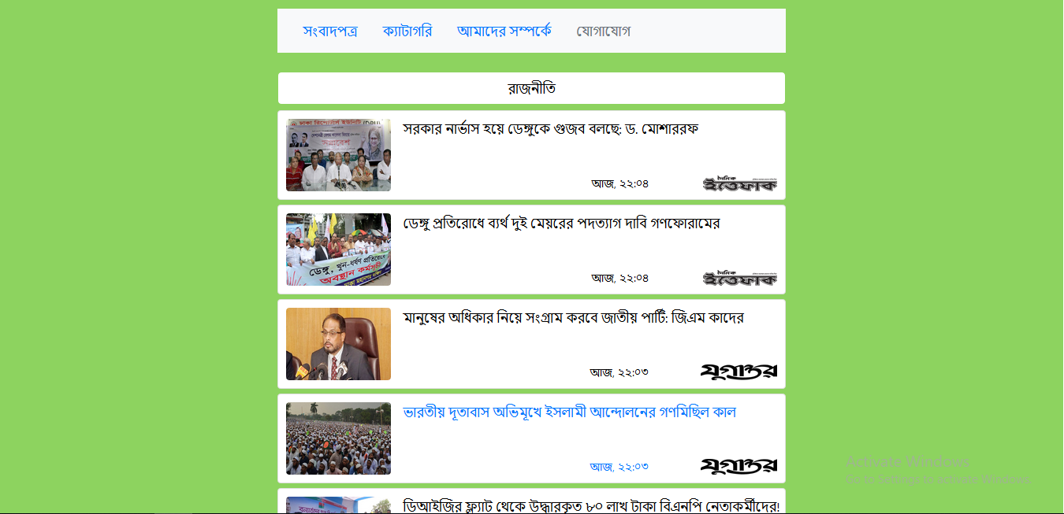

Slide 14
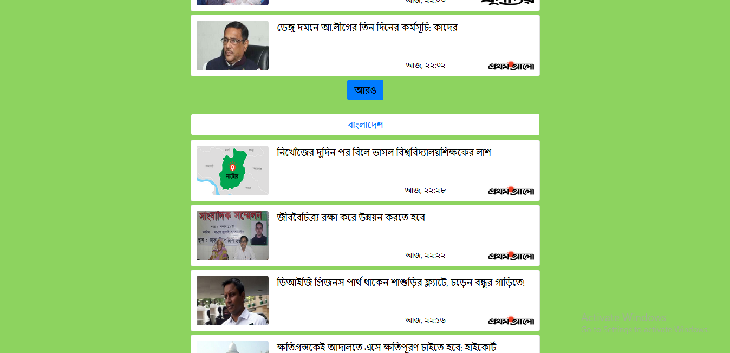

Slide 15
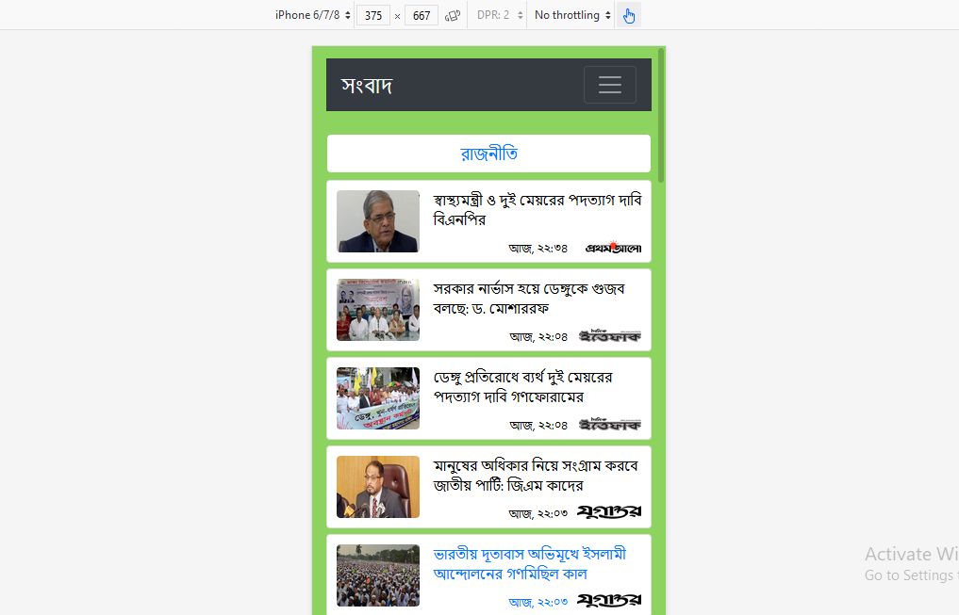
Member Information

Slide 16
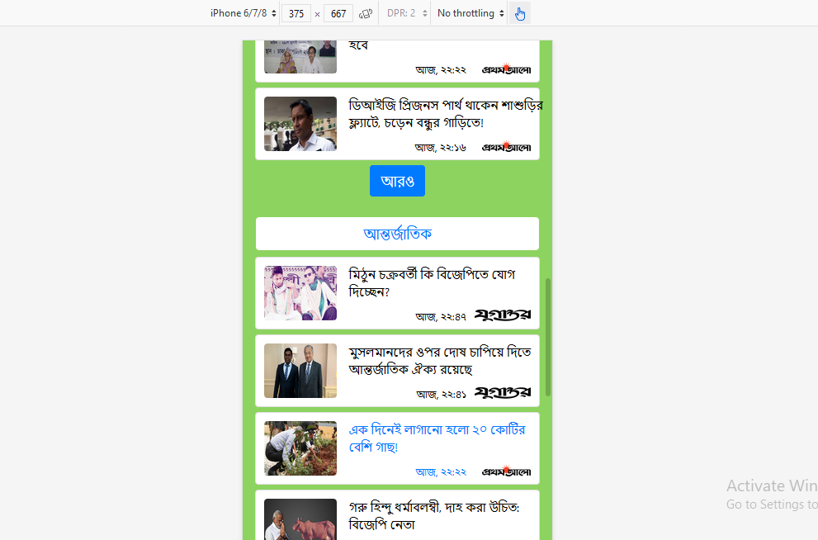
Member Information

Slide 17
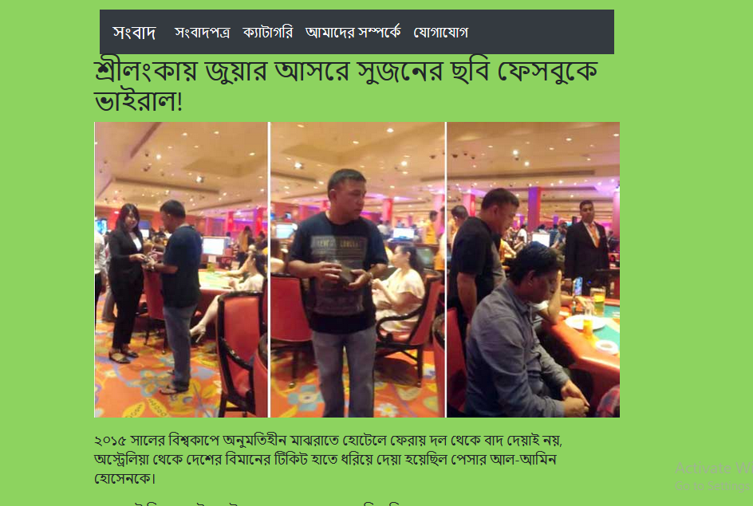
Member Information

Slide 18
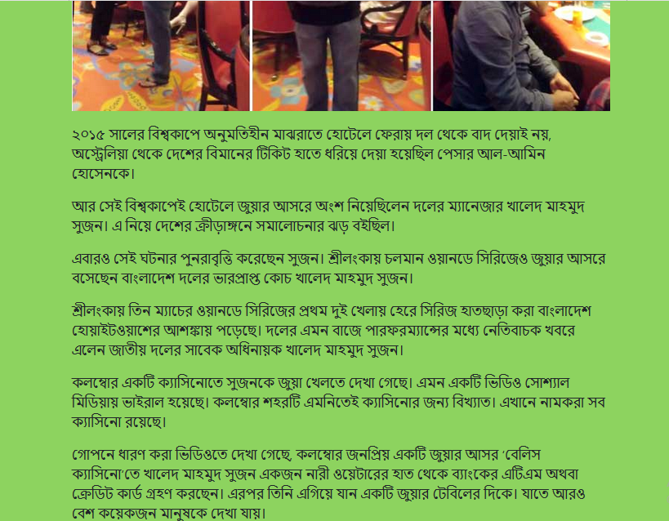
Member Information

